Slide 1
Essential Component of Health Priority Setting: Best Practices in Understanding and Interpreting Cost Data
The Global Health Cost Consortium (GHCC) Reference Case and Unit Cost Study Repository

Slide 2
What do we mean by cost?
Where can I find more information?
What do we use cost data for?
Questions we’d like to help answer
What is the Unit Cost Study Repository?
What makes a good quality cost estimate?
How can I understand if analysis of the cost estimate was done properly?

Slide 3
What do
we mean
by cost?

Slide 4
What are costs?
Human resources
Drugs and other supplies
Equipment
Output
(e.g., per test, per visit, per person treated per year)
Amount
Price
Costing places a value on the total resources used to produce a [health] service

Slide 5
Types of costs?
Financial Costs represent the actual expenditure on goods and services purchased.
Used for budgeting; cost projections; expenditure reviews; affordability/ budget impact analyses
Economic Costs are defined as the opportunity cost or the value of resources used to produce something
Whereas financial costs report expenditures, economic costs include
the value of all resources used
The value includes the value of donated goods, space, airtime, labor and subsidies
Used for efficiency analyses; economic evaluation; budgeting/replication when context and conditions change

Slide 6
The difference between economic and financial costs
TB active case finding
 | Financial cost | Economic cost
Staff nurse who lives in free nursing accommodation | Monthly salary plus transport allowance | Market price for nurses at national level plus transport allowance plus value of the accommodation
Lay volunteer | None | Value of time in next best alternative
Syringe | Price paid for syringe | Market price for syringe
Patient coming in for clinical assessment | Transport cost, meals on the way to the clinic, childcare cost | Opportunity cost of patient’s time spent in transport and at clinic
Xpert diagnostic kit | Price paid | Full unsubsidised price including any distribution and tariff costs.
Computer - donated | None | Market price of computer

Slide 7
Cost Measures
Total Costs (TC): represent the cost of producing a service
e.g., the total cost of active TB case finding at clinic A
Average costs/unit costs: total cost per unit of output
(or TC/Q) with output being measured in different ways
e.g., the cost per person contacted; or the cost per person tested
Marginal cost: the additional cost of producing one more unit of output (looking within a service or project)
e.g., the cost of testing one more person or the cost or carrying out one more test
Incremental cost: additional cost of adding a new service
or project
e.g., the additional cost of adding active case finding to the current TB clinic services

Slide 8
What do
we use cost data for?

Slide 9
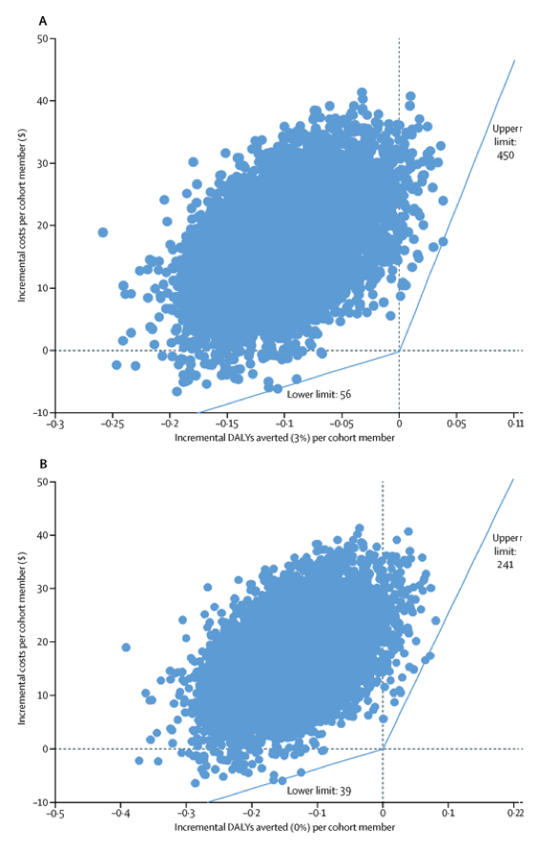
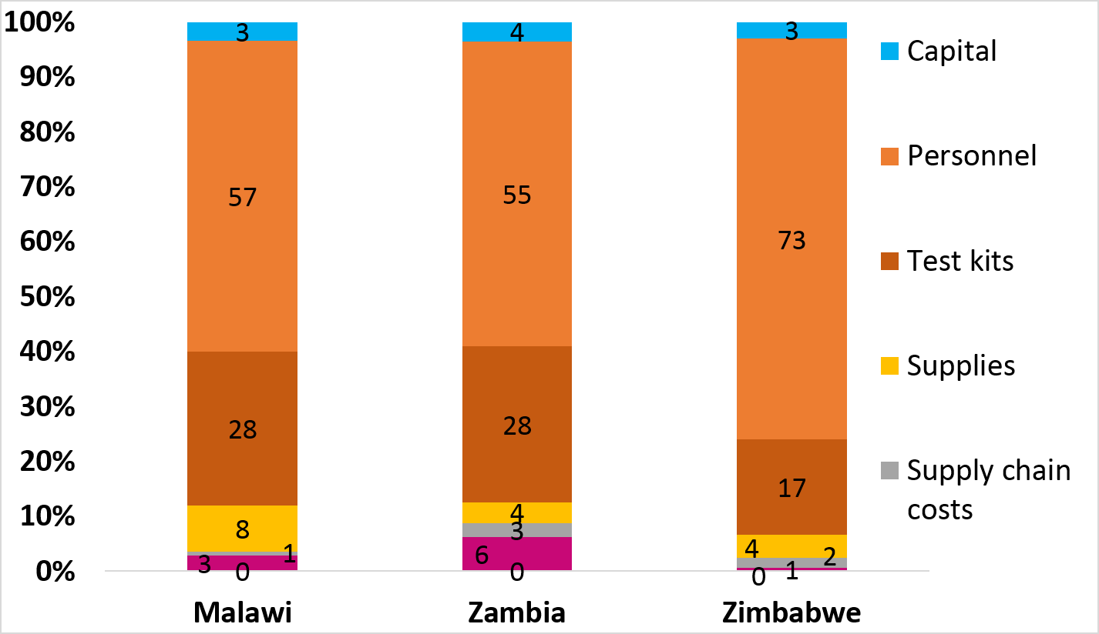
Cost-effectiveness —
Xpert for TB diagnosis
Disaggregated costs
Reference [2]
Reference [1]
Strategic planning models also utilize cost data, including the Spectrum Goals/RNM modules and the AEM model for HIV, and the Optima TB model for TB. These models often have default cost data, but the default values are editable. So, users often ask, should I change the data? And how?

Slide 10
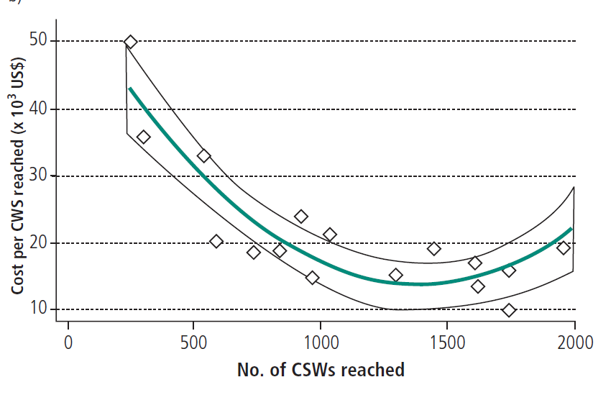
4a and 4b. Scale efficiency
Unit costs of the same program vary by scale, most likely in a nonlinear fashion, making it important to use different unit costs for different service delivery levels.
Reference [3]
Fixed effects model
Random effects model
GLM
Reference [4]

Slide 11
The purpose of the analysis dictates the type of cost data
Budgeting
Financial costs
Forecasting
Economic
costs
Efficiency
Priority setting
Economic
costs
Economic
costs
Financial
costs
Some funders require full economic costing
How are resources being used? How should they be used?
What was spent? How much will you spend?
What will be the financial requirements? What resources are required?
Mathematical models help address these purposes using cost data (either unit or marginal or incremental) together with epidemiologic and program data.

Slide 12
What makes a good quality cost estimate?

Slide 13
What makes a good quality cost estimate?
Statistical properties
  Precision
  Accuracy
Other properties
  Transparent
  Reliable
  Consistent
1. Generalisable
2. Transferable
3. Consistent
https://youtu.be/_LL0uiOgh1E

Slide 14
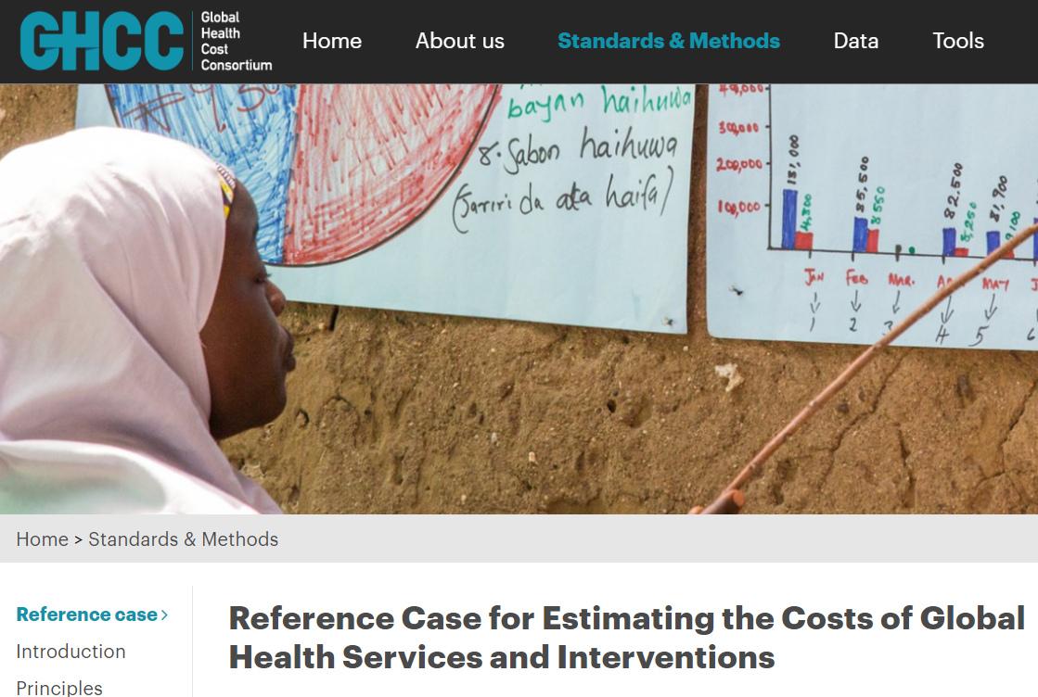
The GHCC Reference Case: ghcosting.org
Set of guiding principles to improve cost estimates
Describes best methodological practice’ to support a cost estimation process that is fit for purpose and efficient given the funding and data available.
Sets minimum reporting standards to improve the transparency of cost estimation

Slide 15
Study Design
Study Design
Principles
of Costing
Analyse and present results
Measure resource use
Value resources
used

Slide 16
Study design (Principles 1–5)
Specify the purpose to define:
Perspective (whose costs?)
Health system Provider Society Patient/client Household
Types of cost?
Financial/ Economic Real world/ guideline
Cost measure
Full Incremental Marginal
Unit of service
Standardised units for different disease and intervention areas Episodes of care/ Unit of service use
Time horizon and period
What is the time horizon you will be projecting to? What time periods need to be captured to be representative?

Slide 17
Two examples…
Cost-effectiveness of TB active case finding
Most Ministries of Health would demand that the economic evaluation takes a societal perspective. Economic costing would be required to ensure that we capture the true opportunity cost Real world costing would be preferable to avoid any systematic bias. An incremental cost would be used and economic evaluation guidance would indicate whether future savings should be incorporated. The time frame needs to be sufficient to cover the cost of the intervention (direct and indirect).
Budget for ART in district Q over the next two years
A provider perspective would be used as we are informing the budget; and Financial costs only — actual expenditures —would need to be included. Real world costs would be the most accurate way to budget but guidelines maybe sufficient and The full costs of the service needed. The time frame will be 2 years
More examples available at the Reference Case: www.ghcc.org

Slide 18
Analyse and present results
Principles
of Costing
Study Design
Value resources
used
Measure resource use

Slide 19
Measuring resource use: scope of the costing
  Describe the intervention/programme fully
  Identify the activities for the specific intervention/programme during the specified time for the specific in that context.
  Identify the inputs that are required for each activity
  Identify the outputs for each activity

Slide 20
The GHCC reference case framework
Intervention
e.g. Provision
of PMTCT
Services
Direct service activities
Antenatal care clinic
HIV testing
Counselling
Provision of ART
Ancillary service activities
HIV test laboratory costs
Information and education campaign
Operational activities
e.g. training, monitoring
Inputs, resource
use and prices
Quantity and price of labour
Quantity and price of consumables

Slide 21
TB active case finding (simplified)
Intervention
Cost per
person tested
Direct and Ancillary Service Activities
Direct service
Ancillary/support services
Activity costs
Personnel – Q(minutes) x cost per minute
Q(visits) x Cost per household visit
Personnel – Q(minutes) x cost per minute
Infrastructure – Q(sq m per min) x cost per sq meter
Q(visits) x Cost per outpatient
visit or inpatient visit
Personnel – Q(minutes) x cost per minute
Infrastructure – Q(sq m per min) x
cost per sq meter
Q(events) x Cost per
community event
Personnel – Q(minutes) x cost per minute
Technology – Q(tests) x cost (infrastructure, consumables, overheads transport, training)
Q(tests) x Cost per test
(by each technology)

Slide 22
Measuring resource use: assessing sampling
Sampling can be at individual or facility level
Sampling frame will be determined by precision demanded
Explicit consideration of each element inline with good practice
Transparency!
Look for sampling from:
    Multiple sites
    Real world (rather than clinical trials)

Slide 23
Methods of measurement: gross or microcosting?
Example: The gross costing approach to estimate the portion of inputs used in TB case finding from overall inputs at the facility
Department A
Service 1
Total inputs
(Facility level)
Ancillary
department
Service 2
Document the process — be transparent!
Department B
e.g. TB clinic
Service 3
e.g. TB case finding

Slide 24
Measuring outputs
Outputs need to be measured at the different levels of analysis
Intervention (e.g case diagnosed); Service (e.g. outpatient visits, tests carried out, monitoring visits completed)
To ensure comparability, standardized output units are needed
Standardized units TB diagnosis and treatment are available at the GHCC reference case, and those for HIV are forthcoming.
Sources include facility or patient surveys, routine data and even focus groups
Remember to report the source of data, report the approach used to sample/fill missing data and justify the approach

Slide 25
Analyse and present results
Principles
of Costing
Study Design
Value resources
used
Measure resource use

Slide 26
Pricing and Valuation: Sources of Price data/shadow prices
Financial costs use expenditures for prices
Economic costs use market prices or shadow prices (where there is no recorded expenditure)
All costs are converted to constant prices using appropriate inflation index (usually a GDP deflator)
Capital costs should be discounted (financial costing) and amortized [annualized] for economic costing.
Valuations in local currency and US dollars.
The technical terms used here are all explained in the GHCC reference case
Any analysis should document the adjustments and sources of any data used

Slide 27
Analyse and present results
Principles
of Costing
Study Design
Value resources
used
Measure resource use

Slide 28
Analysing and presenting results
Explore heterogeneity
Characterise uncertainty
Communicate results transparently

Slide 29
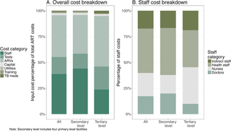
Exploring heterogeneity
Has heterogeneity been explored? If only one cost figure is presented, it may mask differences in cost between:
Technologies (drugs, tests, surgical vs. device, radio vs. social media, etc.)
Service delivery platforms
Target populations
Geographic areas
Seasons
Reference [4]
Reference [5]

Slide 30
Characterizing uncertainty
Sampling that may reflect higher- or lower-cost sites or populations disproportionately, and have more or less precision.
Completeness — what elements of costs are missing (inputs, service use, providers).
Possible under- or over-reporting of elements such as service and time use due to the data collection methods or program features
Distortions or incompleteness in the prices of inputs.
While it may not always be feasible to quantify bias, the characteristics and direction of any bias should be reported in the study limitations.
Cost data reporting needs transparency around each principle described in the Reference Case, so that the data may be interpreted correctly.
Transparency!
Transparency!
Transparency!

Slide 31
The Unit Cost Study Repository:
a resource to complement the Reference Case

Slide 32
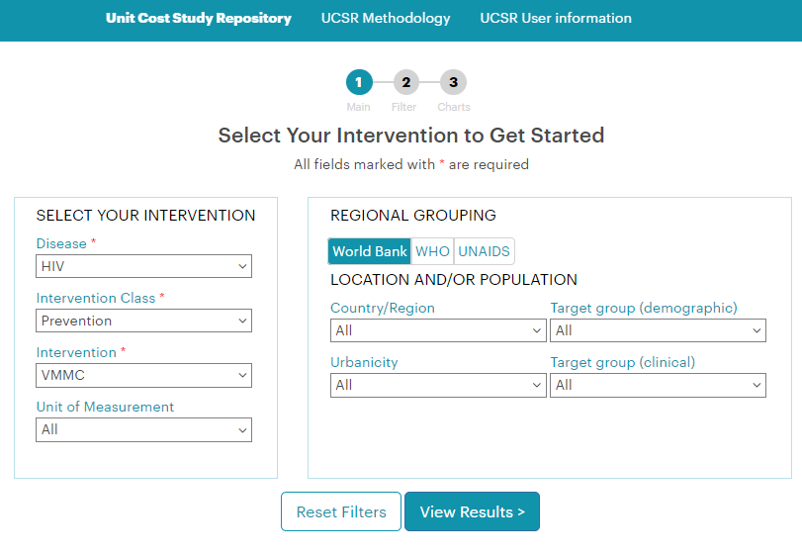

UCSR
Overview
Need for ACCESS to centralized cost data source, with information to assess the QUALITY of cost estimates, without overwhelming the user with data.
Need for ability to sort data by key characteristics: region, country, type of intervention, platform, etc.
Includes 2,577 unit costs from 340 studies up until mid-year 2016 for HIV and TB.

Slide 33
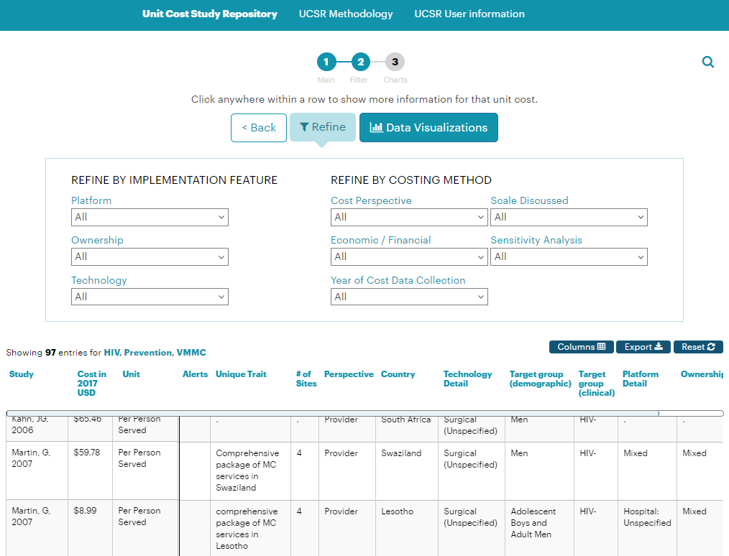
UCSR
Utilization
Choose your intervention in Step #1 and view results. Step #2 allows you to further refine your search.
More detailed information is available by clicking on any row.
The display and filters align with the Reference Case Principles.
Visualize your results through charts in Step #3.

Slide 34

Thank you!
You may find the Reference case and the UCSR at ghcosting.org
Your feedback is welcomed. The online Reference Case has links at the bottom of each page to a discussion forum.
The UCSR pages include a Methodology description, a User Guide, and a link to a Feedback Survey in the main headings at the top of the page.
You may also send questions to contactGHCC@gmail.com
Big Data, Artificial Intelligence, and Decision Science in Health and Nutrition: AN APPLIED SKILLS BUILDING PROGRAM
* Please note, more resources and links are available in the actual presentation that you can download online from the event website.

Slide 35
Other useful information

Slide 36
Other sources
Costing concepts (YouTube videos)
Purpose and short/long run: https://www.youtube.com/watch?v=sPQ4bvTJNTA;
Depreciation: https://www.youtube.com/watch?v=OrBNusmnDxQ;
Opportunity cost: https://www.youtube.com/watch?v=hR5E7Y4Dxuc;
Sampling bias: https://www.youtube.com/watch?v=p52Nep7CBdQ
Guidelines
London School of Hygiene and Tropical Medicine. 2013. Rapid Syphilis Test Toolkit: available at http://www.idc-dx.org/resources/the-rapid-syphilis-test-toolkit
World Health Organization. 2002. Guidelines for cost and cost-effectiveness analysis of tuberculosis control: available at http://apps.who.int/iris/handle/10665/67728
Beck, E. 2011. Manual for Costing HIV Facilities and Services: available at: http://www.unaids.org/en/resources/presscentre/featurestories/2011/may/20110523manualcosting
Creese A, Parker, D. Cost Analysis in Primary Health Care. A Training Manual for Program Managers. WHO Publications Center USA, 49 Sheridan Avenue, Albany, NY 12210 1994.
Drummond M, Schulpher M, Claxton K, Stoddart G, Torrance G. 2015. Methods for the Economic Evaluation of Health Care Programmes. Oxford University Press, United Kingdom.
Economic evaluation
  Wilkinson, Thomas et al. The International Decision Support Initiative Reference Case for Economic Evaluation: An Aid to Thought. Value in Health , Volume 19 , Issue 8 , 921 – 928
Reference Case Sources section:
ghcosting.org/pages/standards/sources/rc_references

Slide 37
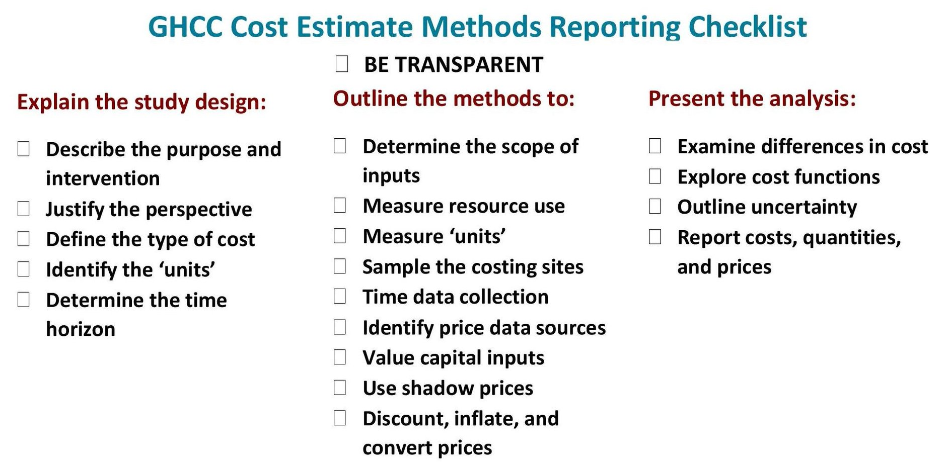
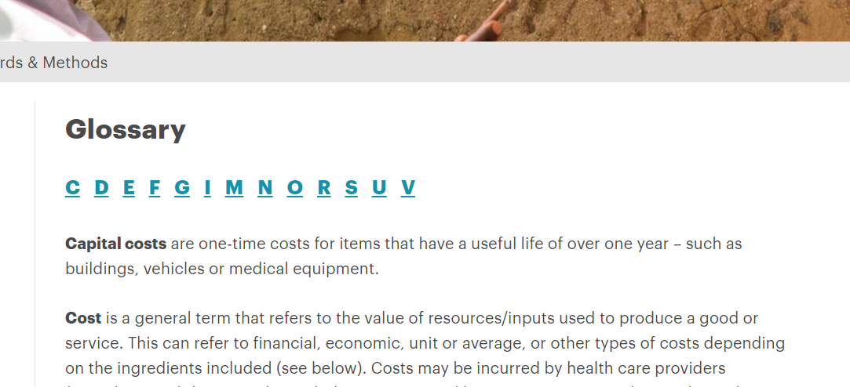

The RC Checklist
https://ghcosting.org/pages/standards/appendices/
principles_and_methods_reporting_checklist
The RC Glossary
https://ghcosting.org/pages/standards/glossary
The GHCC Website
https://ghcosting.org

Slide 38
References in this module
Vassall A, Siapka M, Foster N, Cunnama L, et al. (2017). Cost-effectiveness of Xpert MTB/RIF
for tuberculosis diagnosis in South Africa: a real-world cost analysis and economic evaluation.
The Lancet Global Health 5 (7): e710 - e719
Dutta A, Barker C, Kallarakal A. (2015) The HIV Treatment Gap: Estimates of the Financial Resources Needed versus Available for Scale-Up of Antiretroviral Therapy in 97 Countries from 2015 to 2020. PLoS Med 12(11): e1001907. https://doi:10.1371/journal.pmed.1001907
Mwenge L, Sande L, Mangenah C, Ahmed N, et al. (2017) Costs of facility-based HIV testing in Malawi, Zambia and Zimbabwe. PLoS ONE 12(10): e0185740. https://doi.org/10.1371/journal.pone.0185740
Bautista-Arredondo, S. (2018). Analysis of VMMC unit costs variation and determinants using facility level, primary data from several studies. Powerpoint Presentation at the International
AIDS Economic Network Pre-Conference, July 20 2018.
Bautista-Arredondo S, Amanze O, Fuentes G, Silverman Retana O, et al. (2018). Explaining the heterogeneity in average costs per HIV/AIDS patient in Nigeria: The role of supply-side and service delivery characteristics. PLoS ONE 13(5): e0194305. https://doi.org/10.1371/journal.pone.0194305
Chandrashekar S, Vassall A, Reddy B, Shetty G,et al. (2011). The costs of HIV prevention for different target populations in Mumbai, Thane, and Bangalore. BMC Public Health 11 (Suppl 6): 1-10.

