Slide 1
http://www.ghcosting.org

Slide 2
Bibliometric review of existing guidance on costing
iHEA Boston 2017 Congress,
Boston Massachusetts, USA
8-11 July 2017
Sedona Sweeney
London School of Hygiene and Tropical Medicine
(on behalf of the GHCC team)

Slide 3
Introduction
Objectives of this study
  To identify current resources and gaps in the literature on costing
  To identify evidence to draw upon in development of the reference case
Approach:
  Bibliometric review
    application of quantitative analysis and statistics to publications such as journal articles and their accompanying citation counts
  Survey
Notes:
The objectives of the study were to identify existing resources for methodology on costing – this was both to identify current gaps in the literature, and also to identify evidence to draw upon when developing some of our recommendations for the reference case.
Our approach was two-fold, first we undertook a bibliometric review of all recommendations on costing methods that exist n the literature. Second, we conducted a survey of people who are either users or producers of cost data, to get a sense of their current awareness and use of the guidance that exists.
I’ll flip back and forth between the bibliometric review and survey results, and we’ve also put some results from the survey in the next few presentations.

Slide 4
Bibliometric review: Search Strategy
Sources:
Consultation of experts
Databases
  Pubmed
  Econlit
  Global Health
  Embase
  Web of Science
  IBSS
Manual searches
  WHO
  UNAIDS
  World Bank
Snowballing
Search terms:
Search #1:
("costing" or (cost collect*) or (cost estimat*) or (cost measur*) or (cost valu*) or (cost calculat*) or (cost analys*))
AND
(method$ or methodology or valid* or generalizab* or compar* or approach* or standard$ or guideline$ or recommendation$ or accura* or bias)
Search #2
productiv* or indirect or opportunity or patient or direct or "out of pocket" or "out-of-pocket" AND cost* or loss or burden or expenditure* or spend* or economic
OR
(catastroph* or impoverish*)
AND
(measur* or collect* or valu* or calculat* or method* or analys* or estimat*)
Notes:
For our search strategy – first, we consulted experts in the field on any guidance that they knew of. We next searched 6 databases, and I’ve listed the search terms up here. We conducted two searches to ensure we captured guidance both from the health provider or health system perspective, and from the patient or household perspective.
We use slightly different search terms for each database, just adapting the search to the search style of each database, for example different databases had different truncation methods for words. Overall, our search terms combined word to do with costing, words to do with methods, generalizability, validity, comparability, standards, or recommendations, and then in the case of Econlit, adding keywords referencing health
We also conducted manual searches of the websites for international agencies, and finally we had an extensive snowballing process tracking citations forward and backwards to ensure all references were captured.

Slide 5
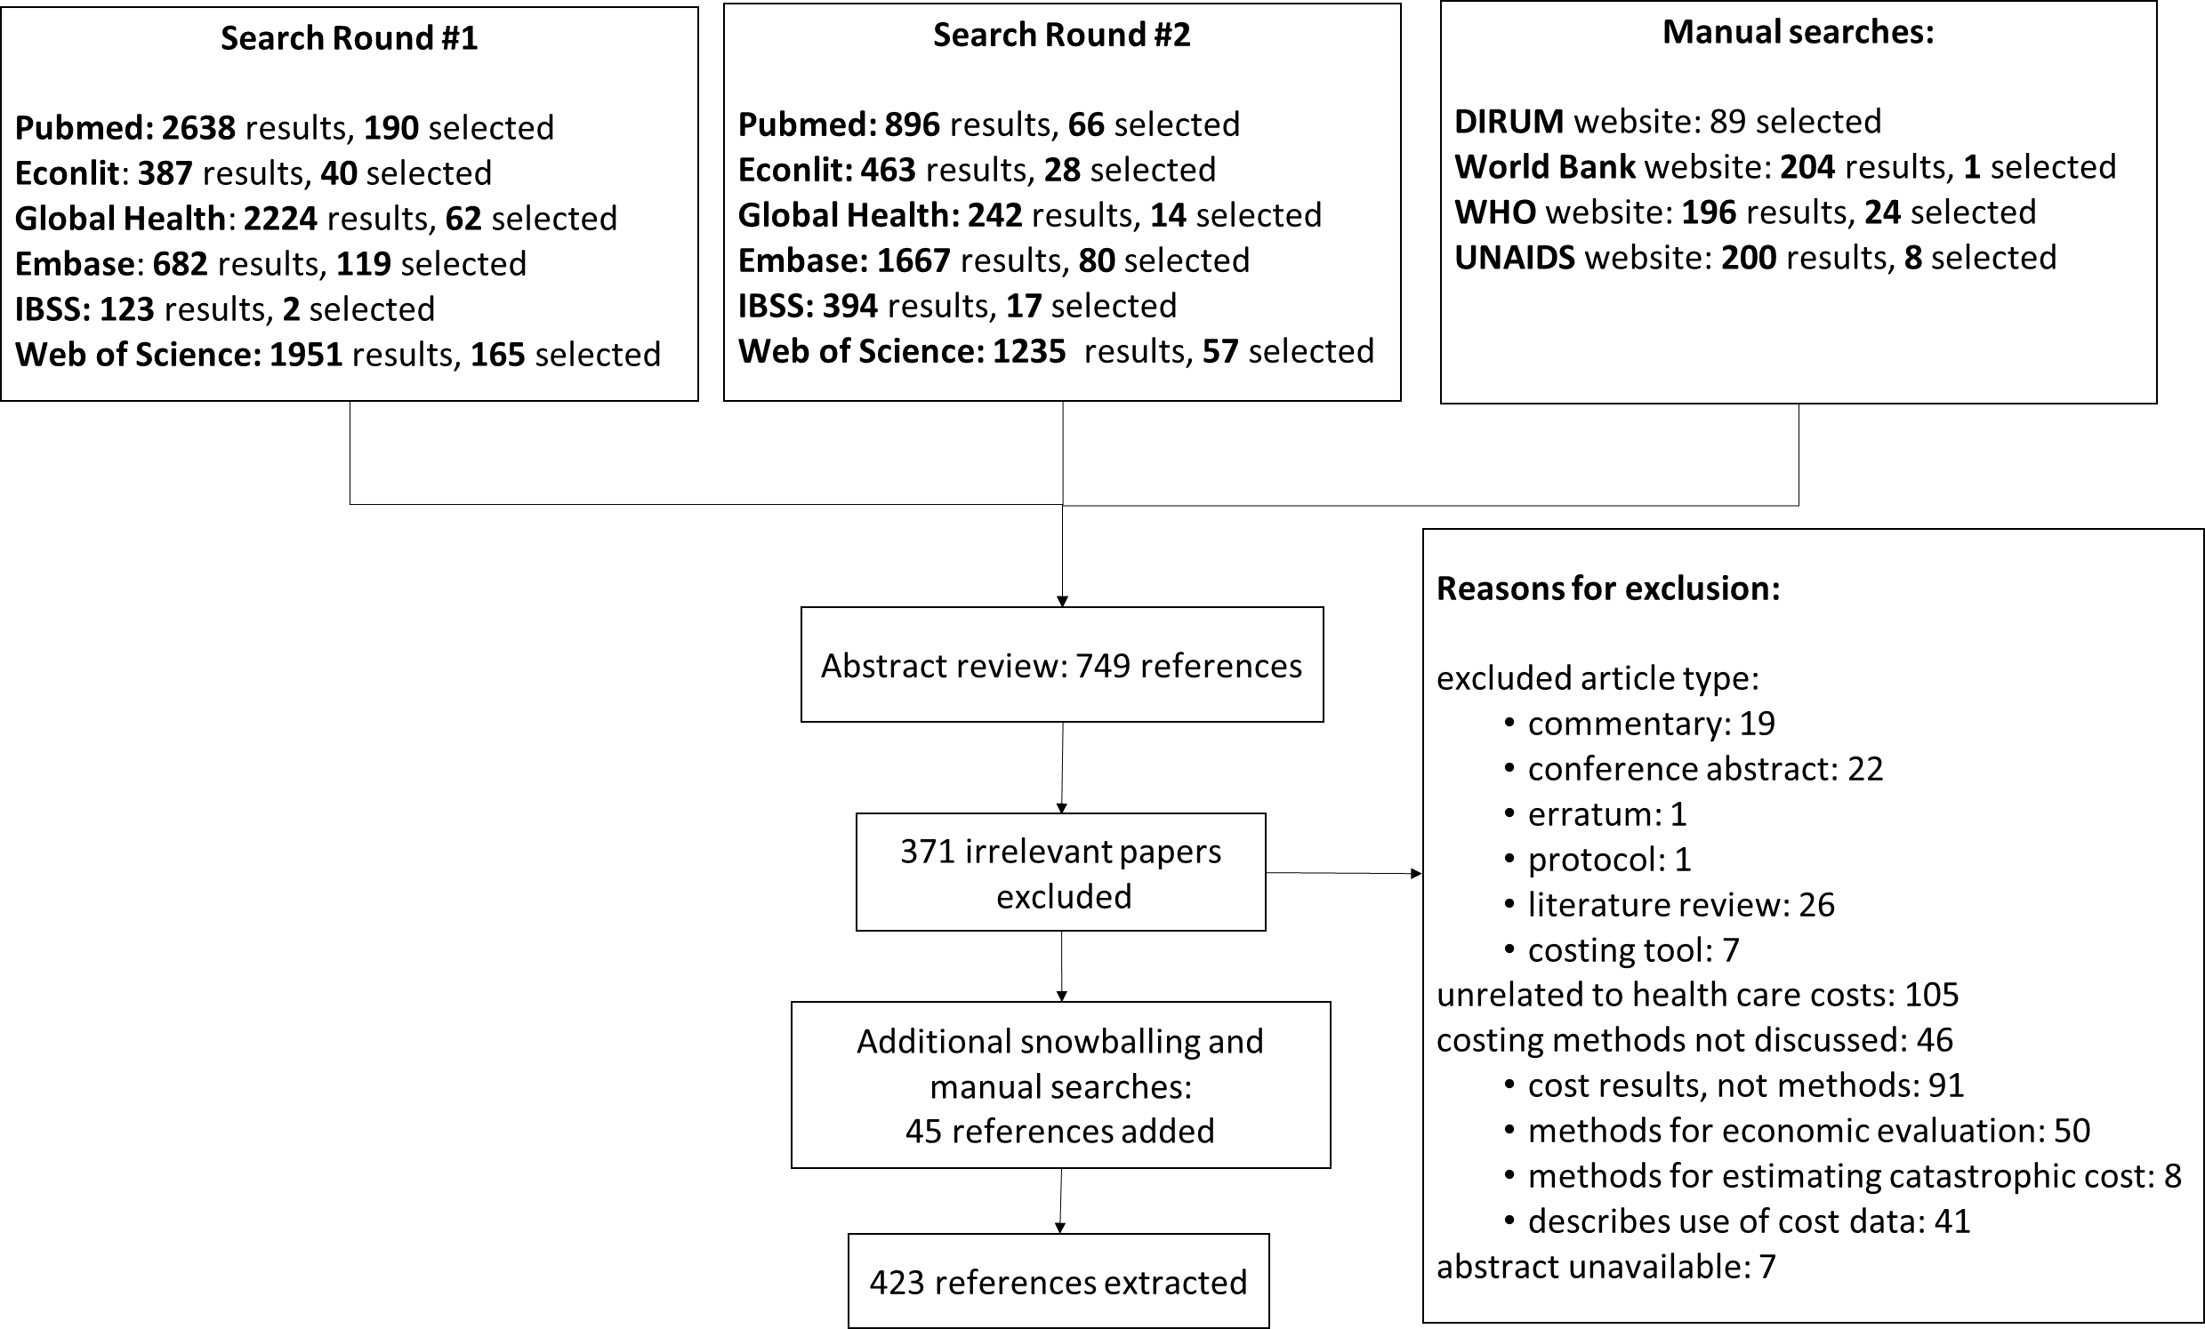
Bibliometric review: Search Strategy
Notes:
I know this slide is a bit small, but the overall process is illustrated here.
Our searches returned a total of 12,901 titles, and we selected 749 papers for the abstract review. In the abstract review we excluded 371 papers, for the reasons listed up here. Snowball sampling and additional manual searches for unpublished literature contributed an additional 45 papers, resulting in a total of 423 references included in the review.
Given that this is a high-level bibliometric exercise, we extracted bibliometric details and information based on the abstracts of papers rather than the full text. We extracted information pertaining to the setting, topic, type of costing that the guidance was pertaining to, and whether the guidance was based on any empirical research.

Slide 6
Costing Tools – not included in the review
HIV tools
Goals
Resource Needs Module
Decision-Makers’ Program Planning Tool (DMPPT)
Future ART Costs
PMTCT
Optima
ASAP HIV/AIDS Costing Tool
VCT Costing checklist
AIDS Impact Model for Business (AIM-B)
Antiretroviral Therapy Unit Cost Spreadsheet
HIV Testing and Counseling Service Delivery Costing Model (HSDC)
Key Populations Costing Workbook
Medication-Assisted Therapy Costing Worksheet
PMTCT and Pediatric ART Costing Tools (PMTCT/Peds)
TB tools
TB Impact Model and Estimates (TIME)
Planning and Budgeting for TB
Other tools
DemProj
AIDS Impact Mode (AIM)
Lives Saved Tool
OneHealth Tool
Marginal Budgeting for Bottlenecks
Integrated Healthcare Technology Package (iHTP)
Costing and Financing Tool for Childhood Immunization
Integrated Health Model
Pipeline Monitoring and Procurement Planning
Supply Chain Manager
ProQ Quantification Software for HIV Tests
Assessment tool for Laboratory Services and Supply Chains Database (ATLAS)
Cost Revenue Analysis Tool
Reproductive Health (RH) Costing Tool
Planning, Costing and Budgeting Framework (PCBF)
CORE Plus
Notes:
Some of these have cost models linked to them
We exclude tools because this is about actual data collection rather than coming to a cost estimate.

Slide 7
Survey: recruitment strategy
Mailing Lists
IHEA
IAEN
healthecon-all (Bruce Hollingsworth)
Regional associations
African Health Economics and Policy Association
Asociacion de Economia de la Salud Latinoamerica y Caribe (AES LAC)
Country associations
Associação Brasileira de Economia da Saúde
China Health Economics Association
Colombian Health Economics Association
Health Economics Association of India
Indian Health Economics and Policy Association
Indonesian Health Economics Association
Nepal Health Economics Association
Singapore Health Economics Association
Turkish Health Economics and Policy Association
Asociacion de Economia de la Salud del Uruguay
Vietnam Health Economics Association
Modelling Consortia
TB-MAC
HIV Modelling Consortium
Individual contacts
GHCC stakeholders
OneHealth tool consultants
GFATM consultants
National Health Accounts reference points (individual emails)
Notes:
For the survey, we advertised on a number of health economics mailing lists, both for international associations, regional associations, and specific country associations. We also circulated an avert with the HIV and TB modelling consortia. Finally, we contacted a number of individuals known to be users/producers of cost data – including GHCC stakeholders, OneHealth tool consultants, Global Fund consultants, and reference points for national health accounts.

Slide 8
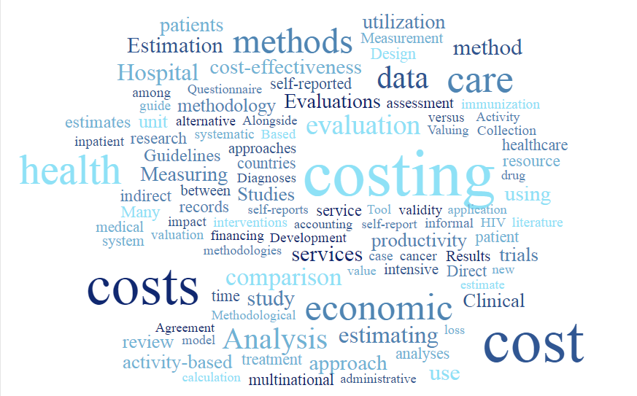
Results
Notes:
So looking at our results

Slide 9
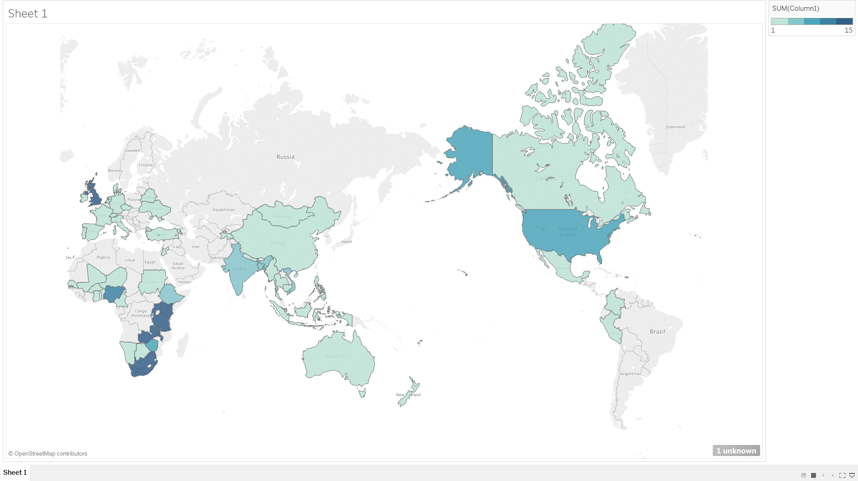

Survey: “What country (or countries) do you currently work in? (maximum 5)”
Notes:
We received 141 responses, with good geographical spread as to countries worked in (although you can see there is a bit heavier representation in sub-Saharan Africa).
Of the 141 respondents, 119 were users of cost data, and 99 were producers of cost data.

Slide 10
When has guidance been published?
Notes:
So looking at when guidance has been published, we’ve seen massive growth in cost guidance over the years. Nearly 40% of these have been methodological papers on one single aspect of costing, such as measurement or valuation. A quarter are guidance on how to cost specific services, and about 10% are guidance on general health services.

Slide 11
What is the nature of guidance?
Notes:
Looking at which diseases they cover, the vast majority of references are not service/disease specific. We see a lot for chronic non-communicable diseases, and a lot for ‘other’ which includes things like alcohol misuse, intensive care, specific surgeries, and so forth.
Just to mention what we don’t see here: there is currently no guidance on coting integrated service, nor nutrition, nor

Slide 12
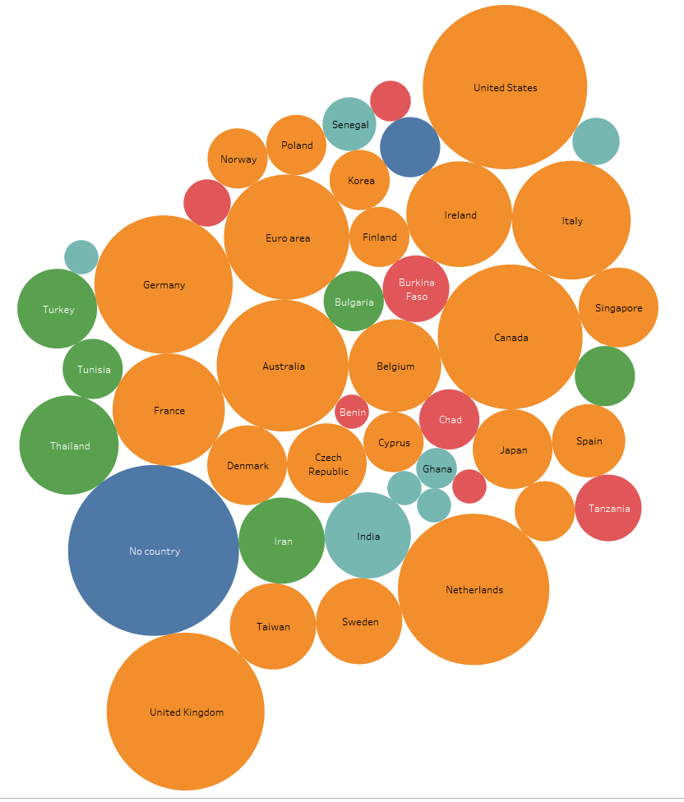
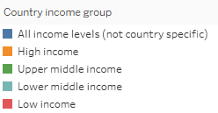
What countries/ areas does the existing guidance concern?
Notes:
Looking at the geography that the guidance concerns, 155 of the 450 were not country specific, aimed at an international audience. As you can see most of the records which are relevant to a specific setting refer to high-income countries in the orange. 22 of the 450 focused on a low or lower-middle income country.

Slide 13
Survey: “To what degree do these methodological resources influence your costing methods?”
Notes:
We asked survey respondents to identify which types of resources tend to influence their costing methods. Over 60% of the respondents reported that they follow general guidelines ‘always’ or ‘frequently’, and over half follow reporting checklists ‘always’ or ‘frequently’. Disease-specific guidelines are followed less often, and other types of guidance including methodological papers on one aspect of costing are the least often followed, with over half of respondents using these ‘sometimes’ or ‘never’

Slide 14
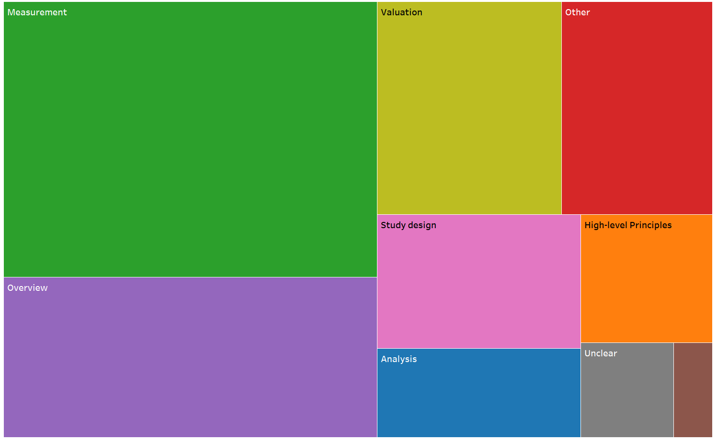
What types of issues are addressed by current guidance?
Notes:
Looking at what types of issues are addressed by the current guidance, we see that about a third of the references give some guidance on measurement of quantities, for example number of visits to a health provider. About 20% are overview guides to costing, most of these are disease-specific. About 15% refer to valuation and just under 10% refer to study design (things lke sampling, selection, etc).

Slide 15
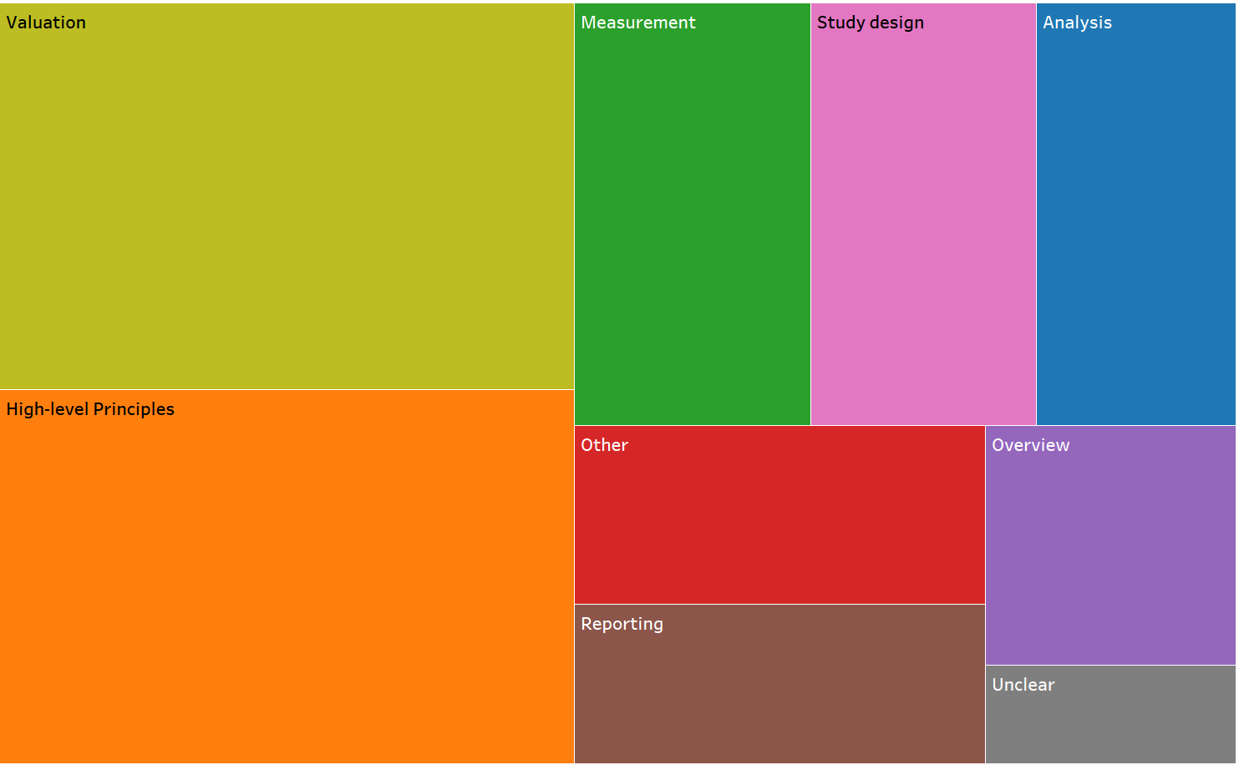
What types of guidance are most often cited?
Notes:
However looking at these same references by number of citations, we see that some aspects of the literature receive far more attention than others. Articles on valuation and high-level principles both receive an average of about 7 citations per year, while things like analysis, measurement, and study design all receive an average of about 3 citations per year

Slide 16
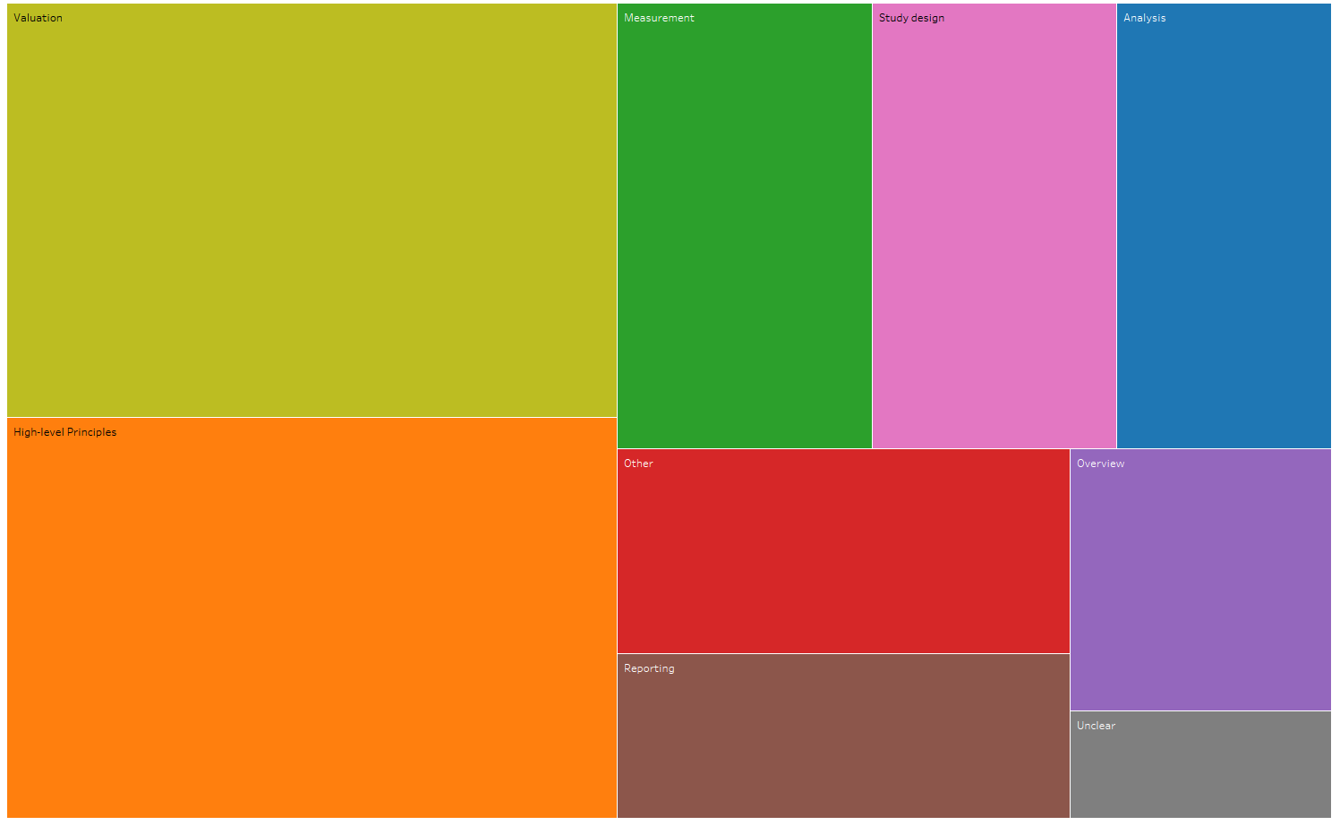
What types of guidance are most often cited?
Mea
Valuation: top 5 most cited
 | Citations / Year
Koopmanschap (1995) The Friction Cost Method for Measuring Indirect Costs of Disease | 47
Kessler (2003) The World Health Organization Health and Work Performance Questionnaire (HPQ) | 44
Koopmanschap (2008) An Overview of Methods and Applications to Value Informal Care in Economic Evaluations of Healthcare | 15
Pauly (2008) Valuing reductions in on-the-job illness: 'presenteeism‘ from managerial and economic perspectives | 14
Van Rojen (1996) Labor and health status in economic evaluation of health care. The Health and Labor Questionnaire | 14
Notes:
The valuation literature base is really dominated by the debate on valuing productivity, and specifically on articles regarding the friction cost approach.

Slide 17
What types of guidance are most often cited?
Mea
High-level principles: top 5 most cited
 | Citations per year
Brouwer (2001) Costing in Economic Evaluations, in Drummond & McGuire Economic Evaluation in Health Care | 32
Oostenbrink (2002) Standardisation of costs: The Dutch Manual for Costing in Economic Evaluations | 24
Luce (1996) Estimating Costs in Cost-effectiveness Analysis, in Gold et al. Cost-effectiveness in health and medicine | 21
Tan (2012) Update of the Dutch Manual for Costing in Economic Evaluations | 18
Johns (2003) Programme costs in the economic evaluation of health interventions (methods for WHO CHOICE) | 18
Notes:
The top-five most cited references on high-level principles on costing are listed here – these are largely book chapters on costing in economic evaluation.

Slide 18
What types of guidance are most often cited?
Mea
Measurement: top 5 most cited
 | Citations per year
Bhandari (2006) Self-Reported Utilization of Health Care Services: Improving Measurement and Accuracy | 26
Ritter (2001) Self-reports of health care utilization compared to provider records | 18
Goossens (2000) The cost diary: a method to measure direct and indirect costs in cost-effectiveness research | 16
Akhavan (2016) Time-driven Activity-based Costing More Accurately Reflects Costs in Arthroplasty Surgery | 15
Roberts (1996) Comparison of self-reported and medical record health care utilization measures | 14
Notes:
However looking at these same references by number of citations, we see that the overview guides to costing receive many more citations than does the topic-specific guidance. Over half of citations go to these overview papers.

Slide 19
What types of guidance are most often cited?
Mea
Overview: top 5 most cited
 | Citations per year
Brenzel (2014) Costs and financing of routine immunization: Approach and selected findings of a multi-country study (EPIC) | 32
Over (2012) HIV Treatment as Prevention: Modelling the Cost of Antiretroviral Treatment—State of the Art and Future Directions | 9
Kolaczinski (2006) Costing the distribution of insecticide-treated nets: A review of cost and cost-effectiveness studies to provide guidance on standardization of costing methodology | 7
Haley (1991) Measuring the costs of nosocomial infections: methods for estimating economic burden on the hospital | 7
WHO (2008) WHO Guide for standardisation of economic evaluations of immunization programmes | 6
Notes:
However looking at these same references by number of citations, we see that the overview guides to costing receive many more citations than does the topic-specific guidance. Over half of citations go to these overview papers.

Slide 20
Costing for purpose
Notes:
Looking at the purpose for costing, the large majority of respondents say that their costing data is used both for economic evaluation and financial planning purposes.

Slide 21
Costing for purpose
Notes:
However looking at the use of references through citations, we see that methods are really driven by guidance on costing for economic evaluation purposes, not financial planning.
Just to mention here that there were a number of references where we couldn’t tell from the abstract what the purpose of costing was – those references are excluded from this graph.

Slide 22
Does any analysis underlie guidance?
Empirical comparison / validation
Case study / worked example
Other analysis
No analysis

Slide 23
Survey: “What in your opinion are the main gaps the current available guidance on costing?”

Slide 24
Conclusions and future work
We see a lot of publications, many on single issues
High-level principles on costing do receive citations, but do not provide detailed guidance on costing
Some detailed guidance (mostly disease-specific), but this is less frequently cited
While there are a number of citations for financial planning/management issues, majority of citations are for economic evaluation purposes
This gives us a solid base to build on – some specific guidance in methods (ie. measurement) can be useful but may not be widely recognized
However there is still a clear need for improving standards in costing

